Slide 1
SkillForge AI Driven Adaptive Learning & Exam Generator
SkillForge is an AI-powered learning platform that adapts to each learner’s pace, performance, and skill level. It analyzes strengths and weaknesses in real time, delivers personalized learning paths, and automatically generates exams, quizzes, and practice tests based on learner progress.

Slide 2
System Architecture
User Interface: Web/Mobile app, communicates via APIs
Backend Server: Handles logic, user data, courses, exams
AI Engine: Adaptive learning, difficulty adjustment, exam generation
Database: Stores users, courses, questions, results
Analytics: Performance tracking, dashboards
Security: Role-based access, encryption

Slide 3
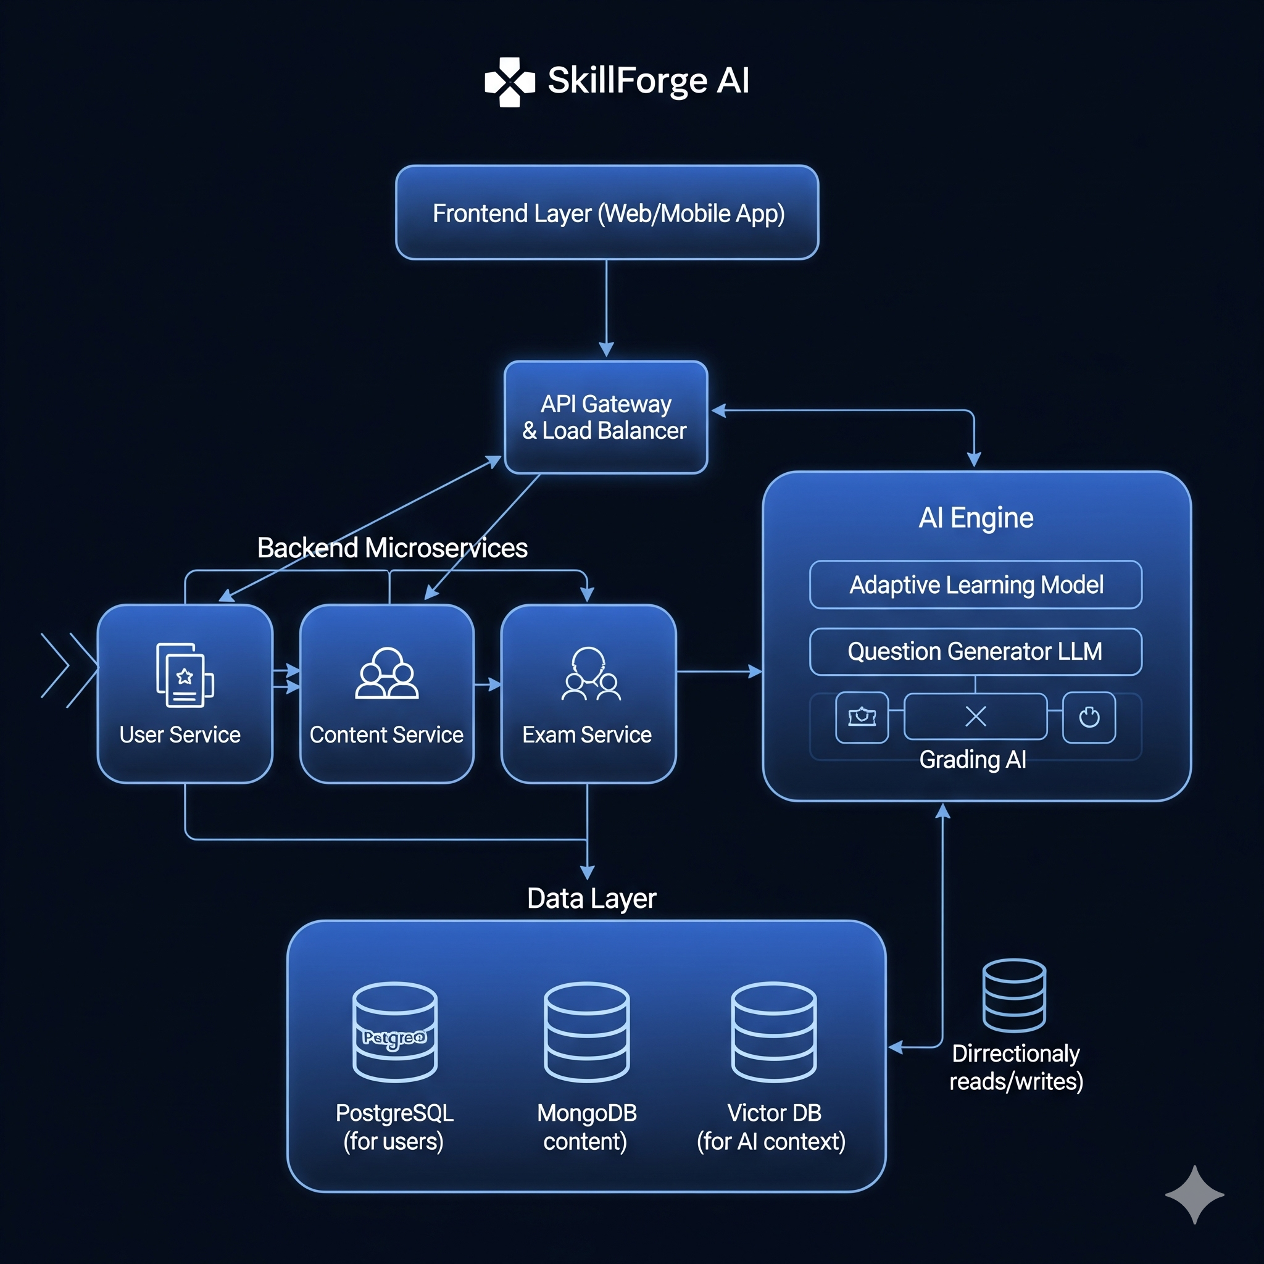
System Architecture

Slide 4
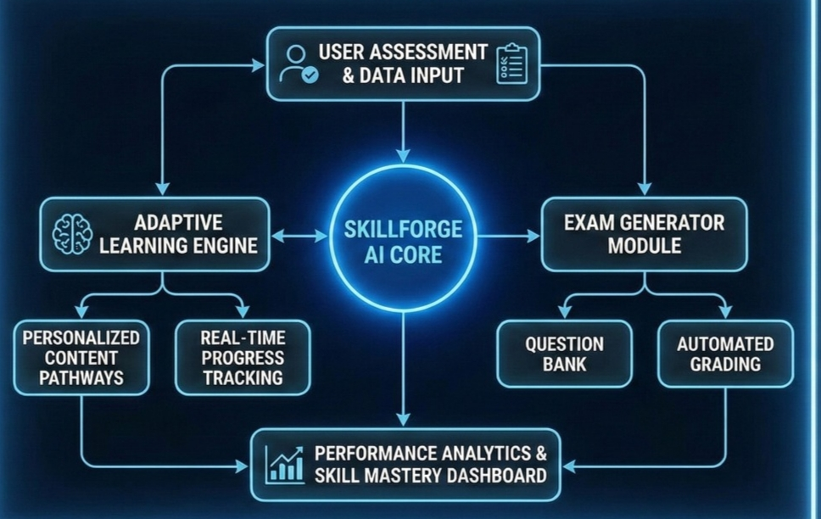
Flow Diagram

Slide 5
Use Cases
Personalized Learning:
AI analyzes user performance and gives customized lessons and practice questions.
Adaptive Difficulty:
Questions become easier or harder based on the learner’s level.
Automatic Exam Generation:
Creates quizzes, unit tests, and full exams instantly with AI.
Progress Tracking:
Shows real-time reports, strengths, and weak areas.
Course Management:
Users can view courses, start learning, and track completion.
Time Saving:
Teachers and students get instant, smart assessments without manual work

Slide 6
ER Diagram (Entities)
Users (Student/Admin)
Courses
Lessons
Exam
Enrollment
Skills

Slide 7
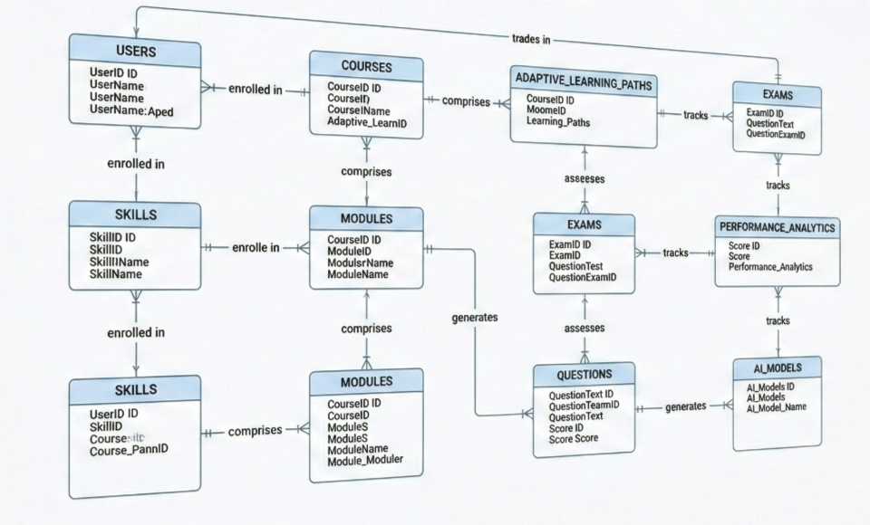
ER Diagram

Slide 8
UI/UX Design Principles
1. Simplicity
Clean, uncluttered interface with clear elements.
2. Consistency
Uniform colors, fonts, and components across the app.
3. User-Centered Design
Focus on user needs, behavior, and usability.
4. Visual Hierarchy
Highlight important information using size, color, and spacing.
5. Accessibility
Readable text, good contrast, assistive support for all users.

